Slide 1

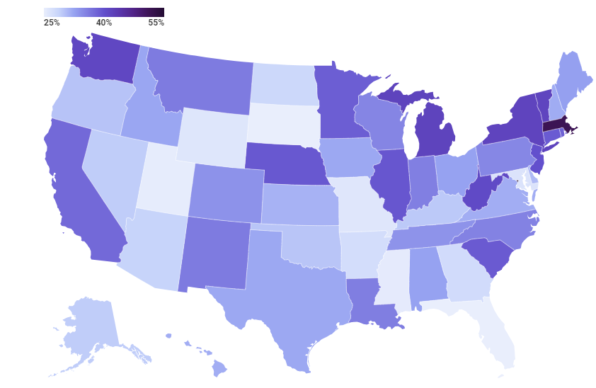
Need for Affordable Daycare Facilities in USA

Slide 2
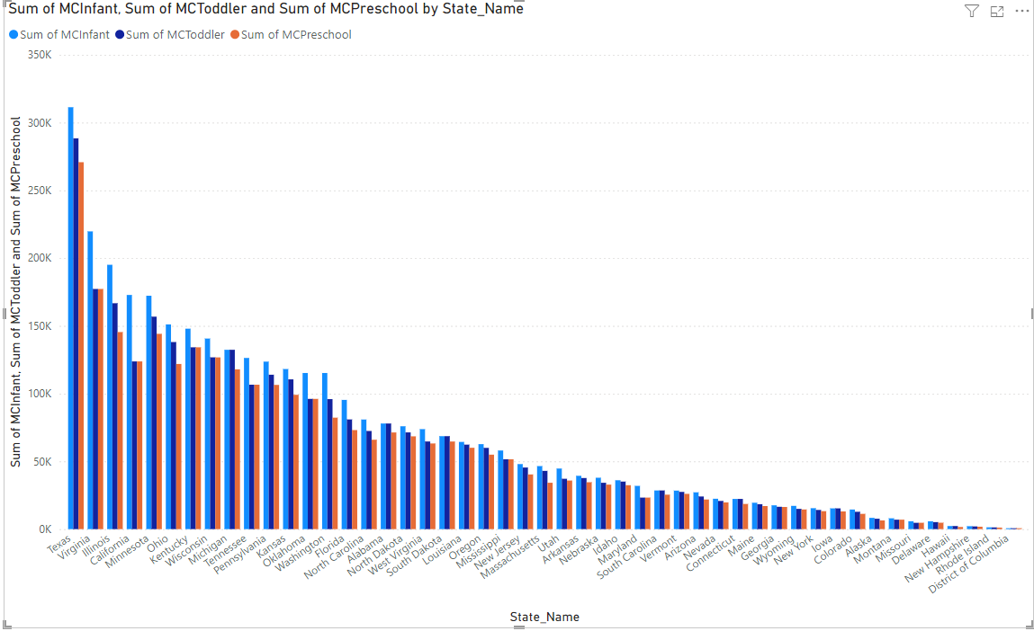
Cost of childcare across different States Attached Visualization shows the cost comparison between MCInfant, MCToddler and MCPreescholl comparison across different states. Most of the states have infant childcare cost significantly high compared to Toddler and preschool with some exception where the infant and toddler is almost aligned.

Slide 3
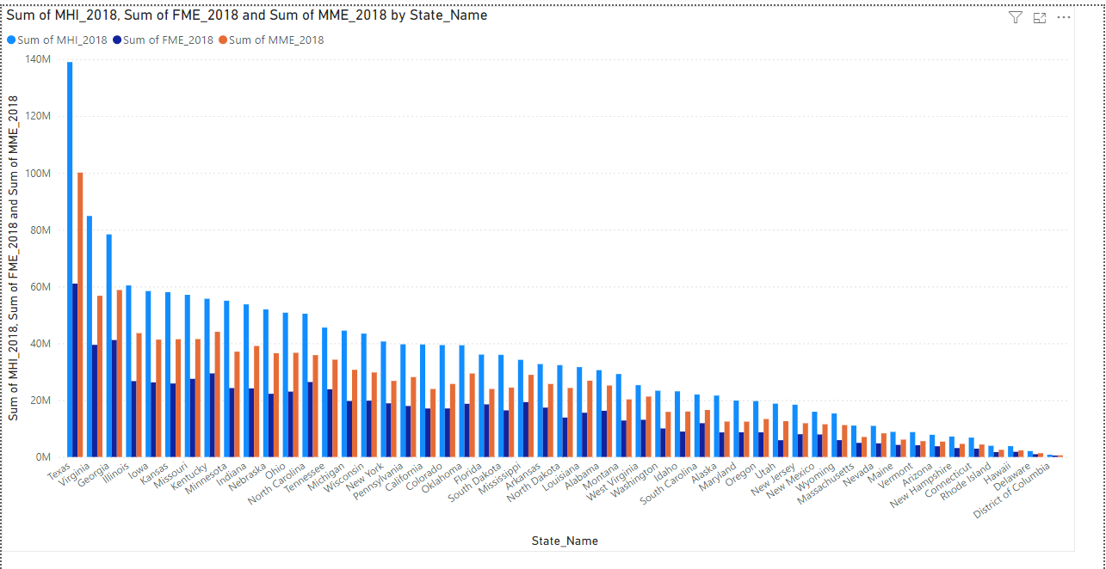
Household income for 2018 comparison across state. Household income comparison for 2018 based the below attributes. MHI_2018 : Median household income expressed in 2018 dollars. FME_2018 : Median earnings for females expressed in 2018 dollars for the population aged 16 years old or older. MME_2018 : Median earnings for males expressed in 2018 dollars for the population aged 16 years old or older.

Slide 4
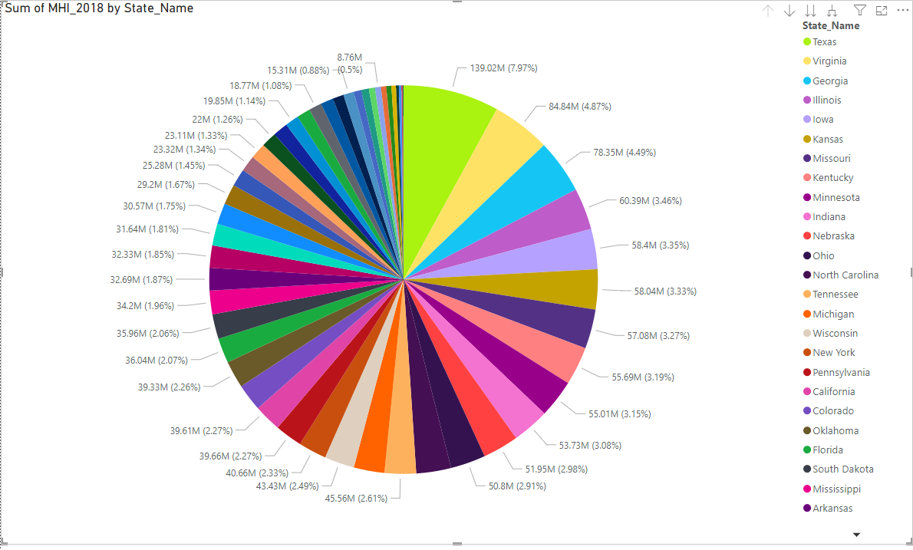
Distribution of Maiden Household Income across state. Attached pie chart shows the Monthly household income in 2018 across different states in United states based on the nationaldatabaseofchildcare.xlsx data.

Slide 5
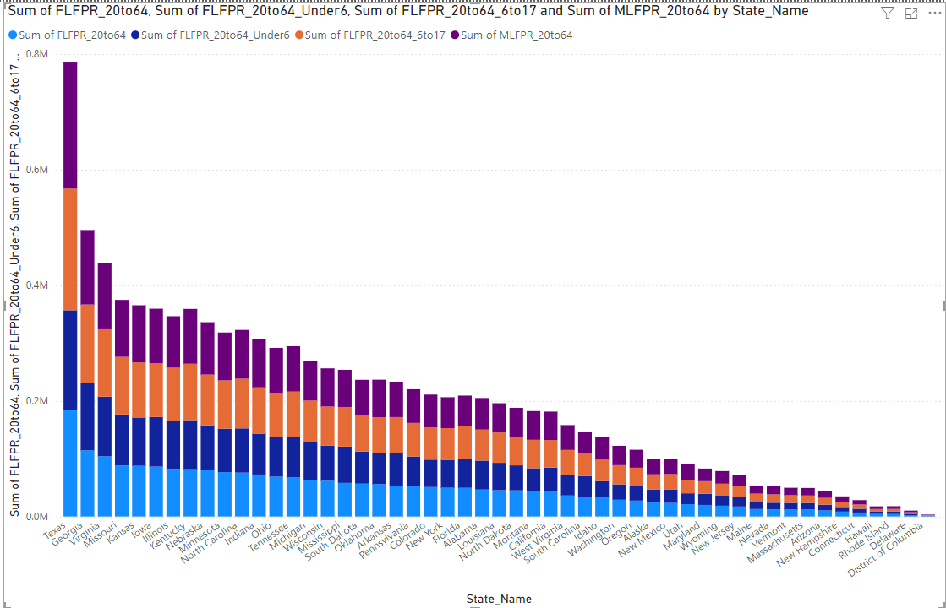
Workforce participation rates by gender and age group Attached chart illustrates how different gender and age groups contribute to the workforce participation in various states or counties. For instance, you can observe the distribution of female labor force participation rates for different age groups (Under 6, 6 to 17, and 20 to 64) stacked over male labor force participation rates. This provides a comparative view of workforce engagement across different demographics, aiding in the analysis of labor trends and policy-making.

Slide 6
Economic Benefits of Affordable Childcare
Boosts Workforce Participation: Affordable childcare increases maternal employment, contributing to higher
household incomes and economic growth.
Enhances Productivity: Access to affordable childcare reduces absenteeism at work, boosting overall productivity and economic stability.
Supports Early Education: Investment in affordable childcare ensures children receive early education, fostering a
more skilled future workforce.
References:
Growing the Economy Through Affordable Child Care - Center for American Progress
Seven Facts About the Economics of Child Care | CEA - The White House
How Affordable Child Care Leads to Global Economic Impact | Bill & Melinda Gates Foundation

Slide 7
Real Stories, Real Impact
What’s The Real Cost Of Child Care In America? - This video discusses the high cost of childcare across the country and the
struggles of both parents and childcare providers. Watch here.
Why Does Child Care Cost So Much Yet Providers Make So Little? - This video explores the disparity between the high cost of childcare
and the low wages of early childhood educators. Watch here.
Parents Testimonials - Kids Club Child Care - While this is from an Australian source, it provides insights into parents' experiences
and views on childcare costs and their child’s development. Read testimonials here.

Slide 8
Proposed Solutions
Increase Federal and State Funding: Allocate more federal and state funds to subsidize childcare costs,
making it more affordable for low-income families.
Expand Childcare Subsidies: Broaden eligibility for childcare subsidies and increase the amount provided to cover a
larger portion of childcare expenses.
Implement Tax Credits: Enhance the Child and Dependent Care Tax Credit to offer greater financial
relief to families struggling with childcare costs.
Support Employer-Sponsored Childcare: Encourage businesses to provide on-site childcare facilities or childcare
benefits as part of employee compensation packages.

Slide 9
Thanks!!!

